Slide 1
Face Detection Using Generative AI
RAHUL KUMAR
REG NO- 712221104501
DEPT- CSE 3RD YEAR
COURSE NAME- GENERATIVE AI FOR ENGG.(E2324)
PARK COLLEGE OF ENGINEERING AND TECHNOLOGY

Slide 2
Agenda
Problem Statement
Project Overview
End Users
Our Solution and Propositions
Key Features
Modeling Approaches
Results and Evolution
Conclusion

Slide 3
Problem Statement
Rapid expansion of digital platforms demands efficient face detection technology.
Current methods face challenges like accuracy, speed, and adaptability to diverse conditions.
A robust solution is required to address these issues effectively.

Slide 4
Project Overview
Our project aims to develop a face detection system using Generative AI.
Leveraging cutting-edge algorithms, we strive to enhance accuracy and speed.
Emphasis on adaptability to various environments and lighting conditions.

Slide 5
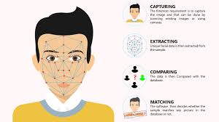
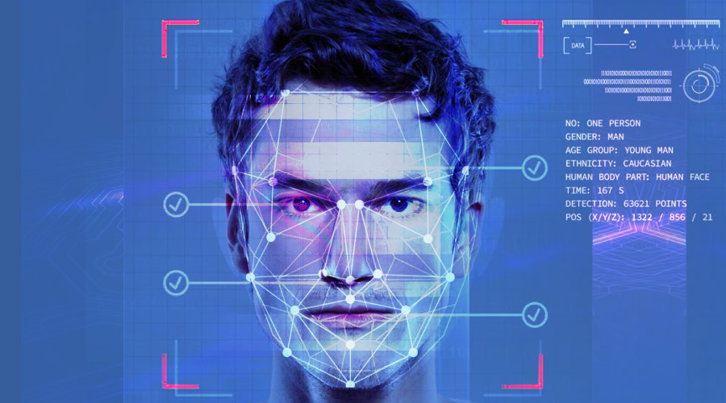
End Users
Social media platforms
Surveillance systems
Entertainment industry
Authentication systems
Automotive industry (for driver monitoring)
Medical imaging

Slide 6
Our Solution and Propositions
Utilizing Generative AI for face detection offers superior accuracy and efficiency.
Our solution prioritizes real-time processing and adaptability.
Integration of machine learning for continuous improvement.

Slide 7
Key Features
High accuracy detection
Real-time processing
Adaptability to diverse conditions
Low computational resource requirement
Scalability for large-scale deployment

Slide 8
Modeling Approaches
Convolutional Neural Networks (CNNs) for feature extraction
Generative Adversarial Networks (GANs) for generating synthetic face data
Transfer learning for adapting to specific domains
Reinforcement learning for dynamic environment adaptation

Slide 9
Results and Evolution
Initial testing shows promising results in accuracy and speed.
Continuous improvement through feedback loops and data augmentation.
Future enhancements include:
Multi-face detection
Occlusion handling
Improved performance in low-light conditions

Slide 10
Conclusion
Our Generative AI-based face detection system offers a robust solution to contemporary challenges.
Striving for excellence in accuracy, speed, and adaptability.
Continuously evolving to meet the dynamic demands of digital platforms and industries.

Slide 11
THANKING YOU !
Naan Mudhalvan

